Slide 1



Integrated Program in Business Analytics
Analysis on Movies Produced and Released in USA from 1980 to 2019
Group A
IPBA Batch 17
06th April 2024

Slide 2
Agenda
Business Problem and Objectives
Executive Summary
Data Overview and Key Business Assumptions (if any)
Data Preparation and Pre-processing
Sanity checks, treatment and transformations for analytical dataset preparation
Exploratory Data Analysis
Key Business Findings and Insights
Model Development and Validations
Model comparisons on key scoring metrics and model finalization
Business Recommendations and Potential Business Impact
Next Steps
Appendix

Slide 3

Business Problem and Objectives
The business problem that this project aims to address is the challenge faced by the Production House/Investor in efficiently allocating financial resources across various movie projects to maximize profitability and success rates. In the highly competitive and risk-prone entertainment industry, making informed budgeting decisions is crucial for the sustainability and growth of a production house. The problem encompasses:
Resource Allocation Efficiency: The production house must allocate its budget in a way that maximizes returns on investment. This involves deciding how much to invest in each movie project and requires a deep understanding of the financial dynamics of different movie genres.
Market Trends Analysis: The entertainment market is constantly evolving, with varying audience preferences and consumption patterns. The production house needs to understand past and current market trends to predict future successes accurately.
© 2021 Jigsaw Academy Education Pvt Ltd.

Slide 4
Business Problem and Objectives
Risk Mitigation: Investing in movie production involves significant financial risks. The production house needs to identify strategies to minimize risks associated with budget overruns, market misalignments, and project failures.
Profitability Optimization: The ultimate goal of any investment is to generate profit. The production house seeks to optimize the profitability of its portfolio of movie projects by making strategic budgeting decisions based on comprehensive data analysis.
Competitive Advantage: In a crowded market, the production house needs to establish a competitive advantage by producing high-quality, appealing movies within reasonable budgets, ensuring they stand out among competitors.
Audience Engagement: By forecasting IMDb scores, production houses can anticipate how well-received their content will be by the audience. This insight enables them to tailor their offerings to better align with audience expectations, leading to increased engagement and viewer satisfaction.
© 2021 Jigsaw Academy Education Pvt Ltd.

Slide 5
Business Problem and Objectives
The objective of this project is to analyse past movie trends and provide Party A, the Production House/Investor, with a comprehensive breakdown of budget recommendations for different movie genres. The goal is to optimize the allocation of resources to ensure the production of successful and profitable movies. Through this project we intend to provide desired data points to the production house, thus they can define their content strategy, mitigate risks and maximise revenues by optimally engaging their audience.
© 2021 Jigsaw Academy Education Pvt Ltd.

Slide 6

Executive Summary
© 2021 Jigsaw Academy Education Pvt Ltd.

Slide 7




Executive Summary
Introduction: This presentation outlines a strategic project undertaken to help a Production House/Investor with data-driven insights for optimizing movie production investments.
Business Problem: Production House/Investor faces varied problems including inefficiencies in resource allocation, risk mitigation, revenue forecasting, and achieving a competitive edge in a saturated market.
Project Objective: The project's aim is to leverage past movie trends for crafting genre-specific budget recommendations, intended to optimize resource distribution for success and profitability.
Methodology: We utilized the CRISP-DM framework, progressing from defining the problem to deploying a solution, ensuring efficiency and alignment with stakeholder objectives.
© 2021 Jigsaw Academy Education Pvt Ltd.

Slide 8




Executive Summary
Key Findings –
Genre Analysis.
Season Analysis.
Fate Analysis.
Trend Analysis.
Budget Recommendations: Provides actionable budgeting strategies for each genre, grounded in data analysis, aimed at minimizing financial risks while maximizing potential returns.
Strategic Insights: We have identified the least risky genres and their optimal time for release with an indication of their optimal budget range and risk rating for a particular project. We have also been able to forecast the revenue of future projects.
Implementation Roadmap: Outlines pragmatic steps for Production House/ Investor to implement the recommendations, with considerations for dynamic market adaptability.
© 2021 Jigsaw Academy Education Pvt Ltd.

Slide 9


Executive Summary
Conclusion & Next Steps: Consolidates the presentation's key takeaways, emphasizing the projected impact on Production House/ Investor's operational success, and suggests avenues for continuous strategy refinement.
Q&A: Invites queries and discussions, facilitating deeper engagement with the subject matter.
© 2021 Jigsaw Academy Education Pvt Ltd.

Slide 10
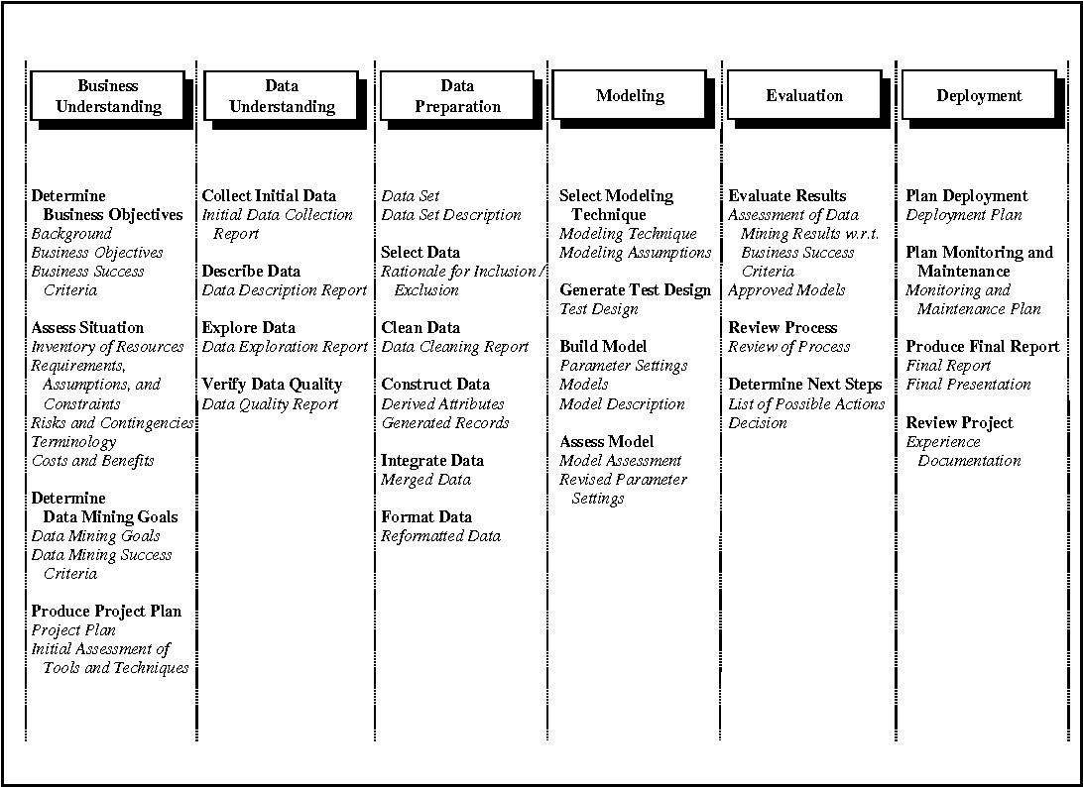
CRISP DM Framework
© 2021 Jigsaw Academy Education Pvt Ltd.

Slide 11
Data Overview
Feature Name | Feature Information
Name | Title of the movie
Rating | The MPAA rating (e.g., PG, R)
Genre | Genre of the movie (e.g., Drama, Adventure).
Year | Release year.
Released | The release date and location.
Score | IMDb rating of the movie.
Votes | Number of votes the movie received on IMDb.
Director | Director of the movie.
Writer | Writer of the movie.
Star | Leading actor/actress.
Country | Country of production.
Budget | Production budget.
Gross | Worldwide gross revenue.
Company | The production company.
Runtime | Length of the movie in minutes.
URL: https://www.kaggle.com/datasets/ashishkumarjayswal/movies-updated-data
Dataset downloaded from Kaggle
Created by the original uploader Ashish Kumar Jayaswal by using the IMDB API
Download Date: 25th November 2023
Dataset for the Period: 1980 to 2020
Original Dataset Size: 1.29 MB
No of Rows: 7668
No of Columns: 23 (inclusive of 8 undefined columns)
© 2021 Jigsaw Academy Education Pvt Ltd.

Slide 12
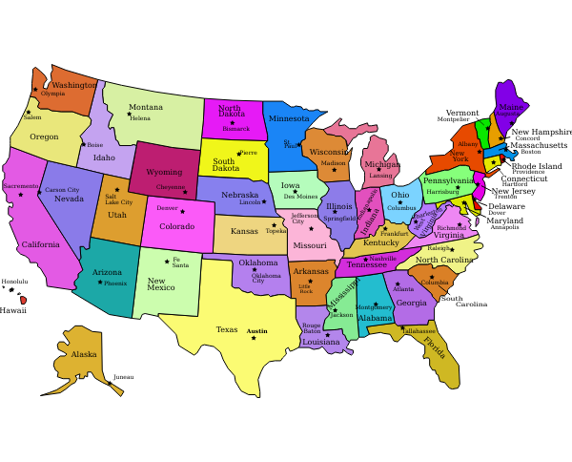
Key Assumptions
We have assumed this is complete data of all movies released during these 39 years timeframe and there is no bias in data.
© 2021 Jigsaw Academy Education Pvt Ltd.

Slide 13
Data Preparation
01
Dropped Columns
02
Dropping Genres
Unnamed Columns and null values
Western and Sports
03
04
Dropped Year
Dropped Rating
“Approved” has been dropped with name tarzan
2020 year has been dropped
© 2021 Jigsaw Academy Education Pvt Ltd.

Slide 14
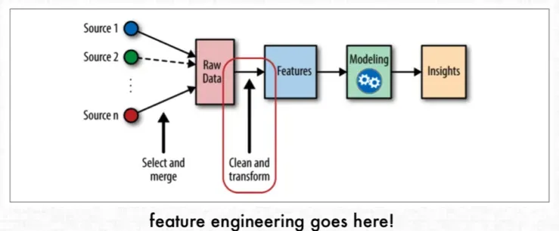
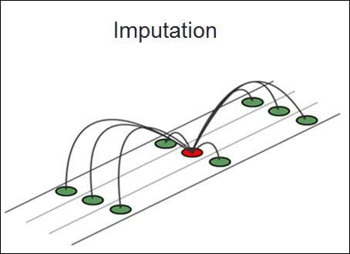

Data Preprocessing
Feature Reengineering
1
Missing Value Imputation
2
Inflation Adjustment
3
© 2021 Jigsaw Academy Education Pvt Ltd.

Slide 15

Exploratory Data Analysis (EDA)
© 2021 Jigsaw Academy Education Pvt Ltd.

Slide 16
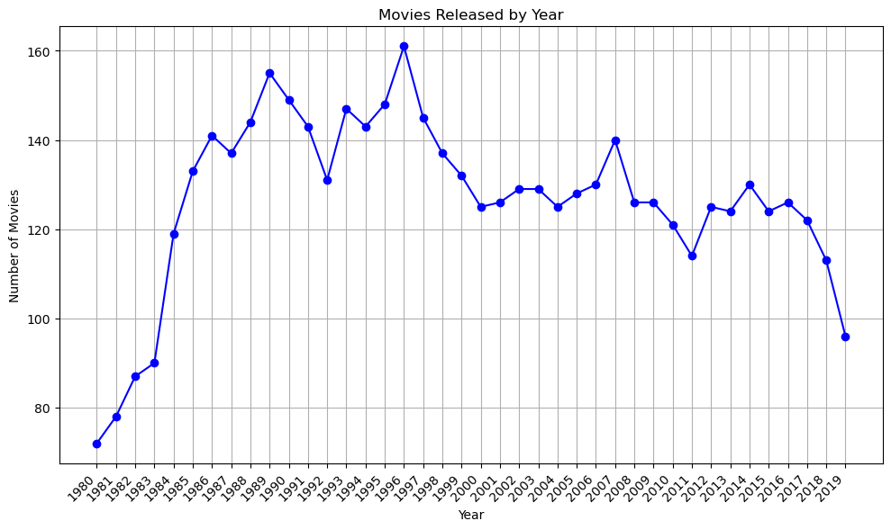
Key Business Finding and Insight # 1
Movies Release Trend YoY
Analysis of movies released YoY shows a trend, which increased continuously for decade from 1980 to 1990. From 1990 to 2000 there was a fluctuation in number of movies released , while from 2000 to 2010 there was almost similar number of movies released every year except in year 2007. Post 2010 also number of movies released every year were rangebound. Though towards end of decade a decline was observed.

Slide 17
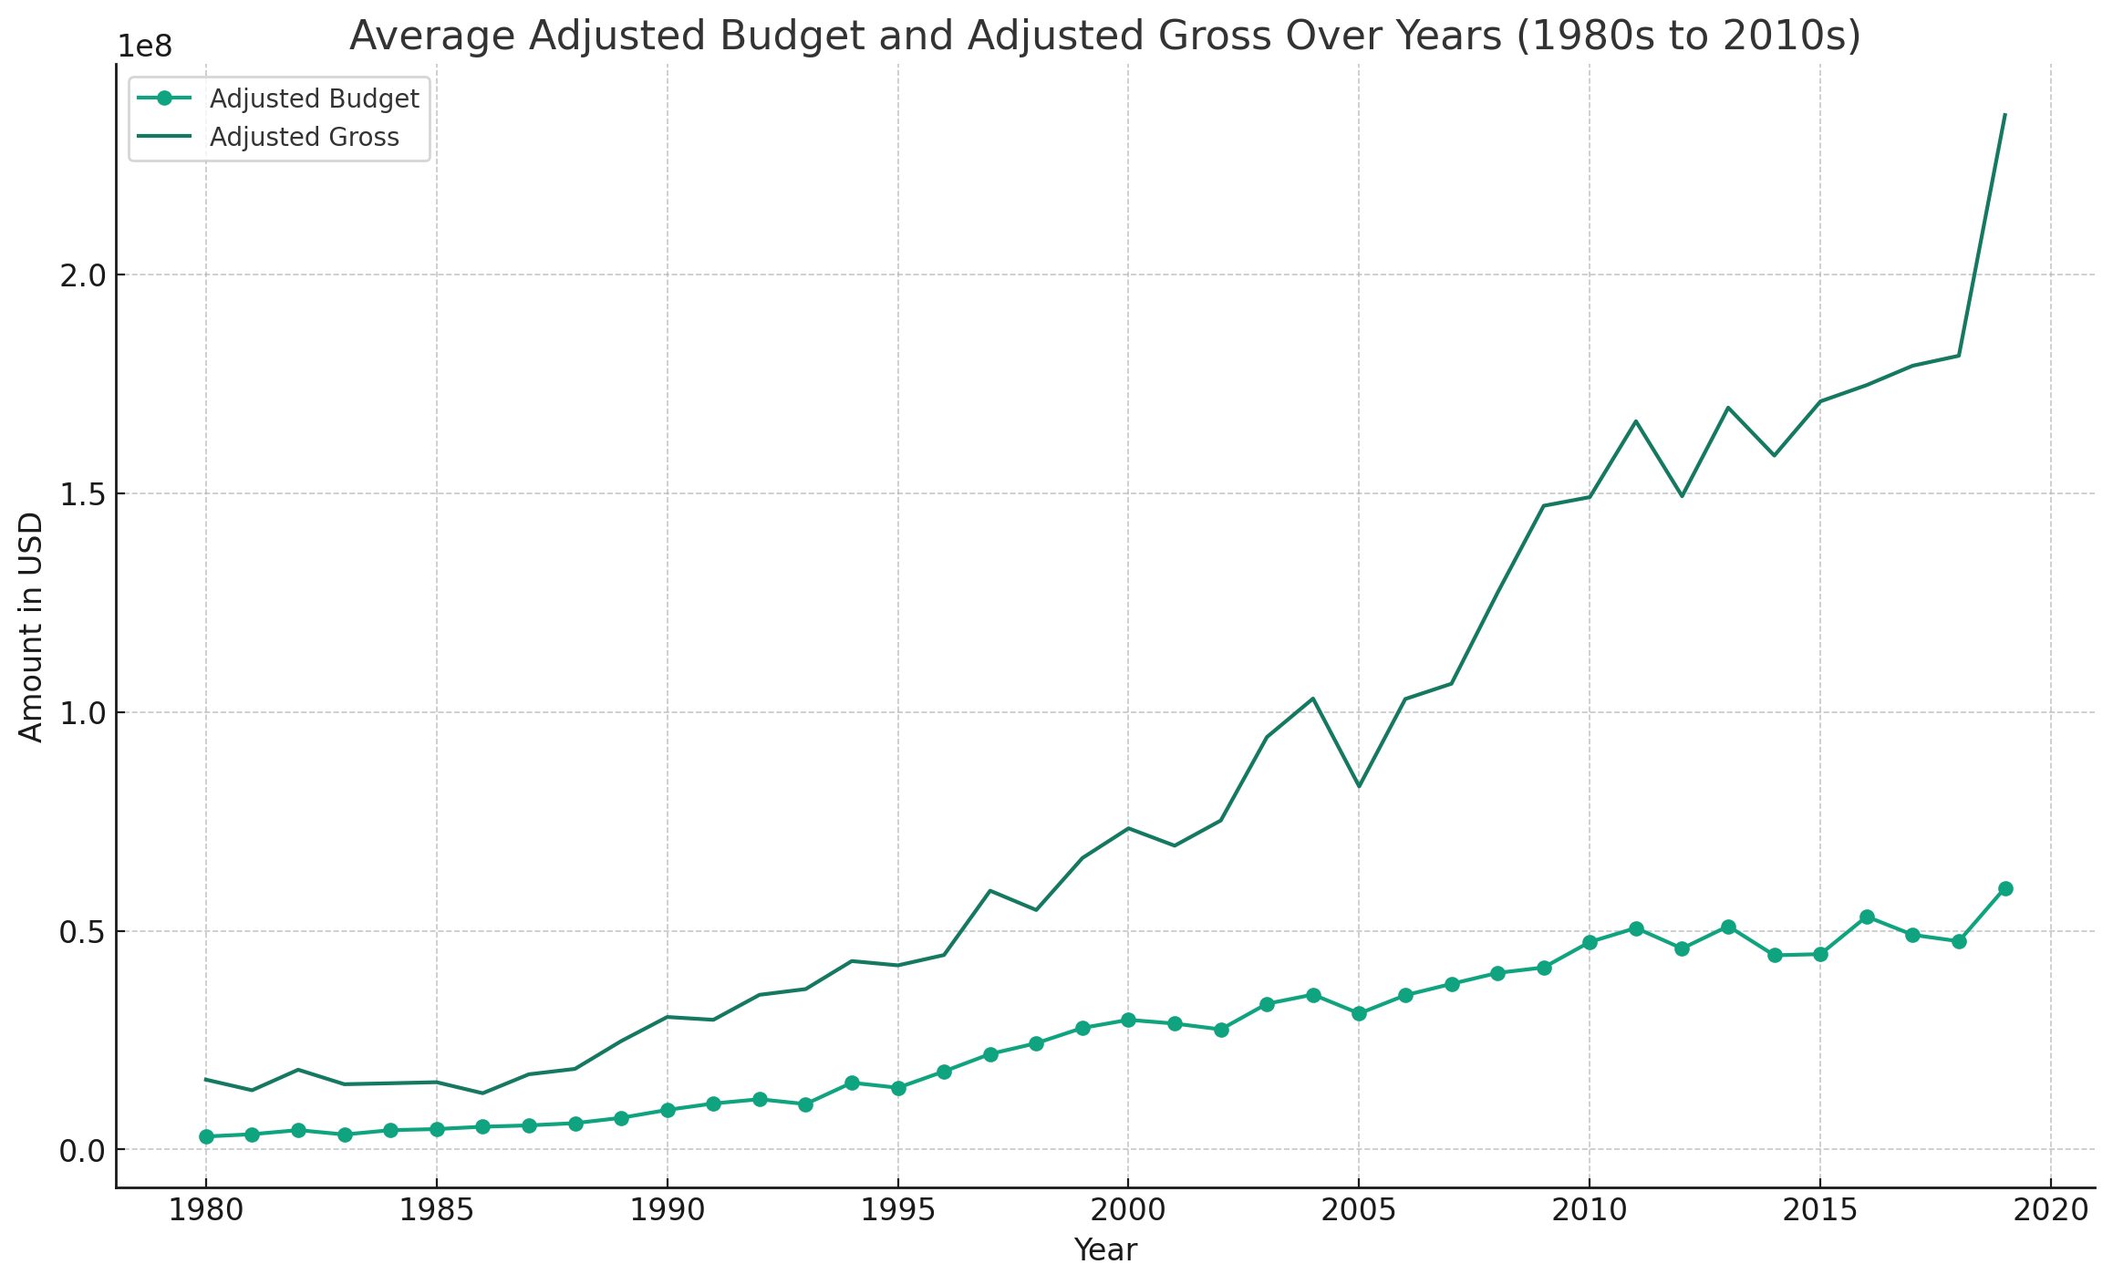
Key Business Finding and Insight # 2
Over span of 30 years, average adjusted budget has increased manifold as compared to the adjusted gross.

Slide 18
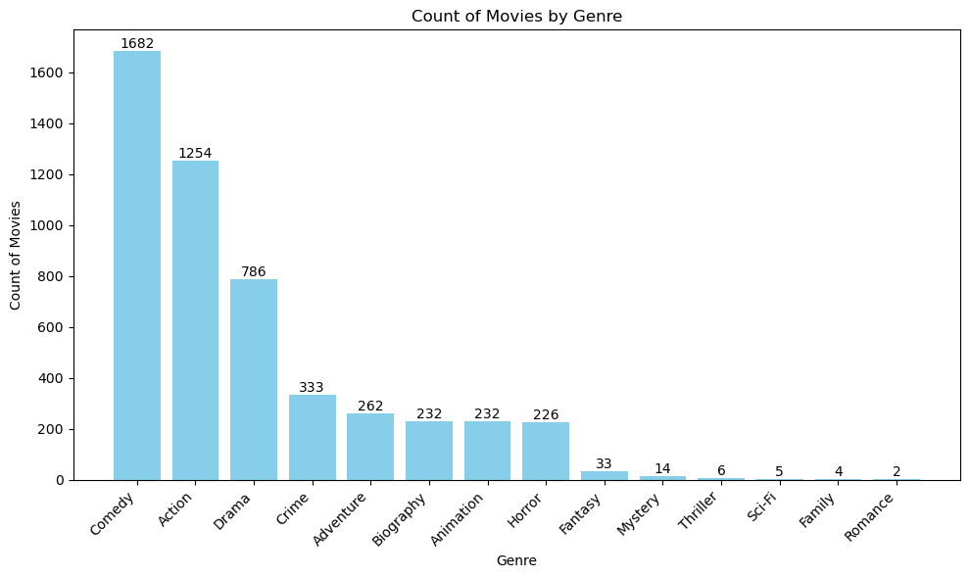
Key Business Finding and Insight # 3 (a)
Movies Released by Genre
Analysis of movies by ‘genre’ shows Comedy, Action and Drama were the top three preferred genres, comprising of almost 75% released movies. Sci-Fi, Family and Romance were the genres which saw minimum number of releases.

Slide 19
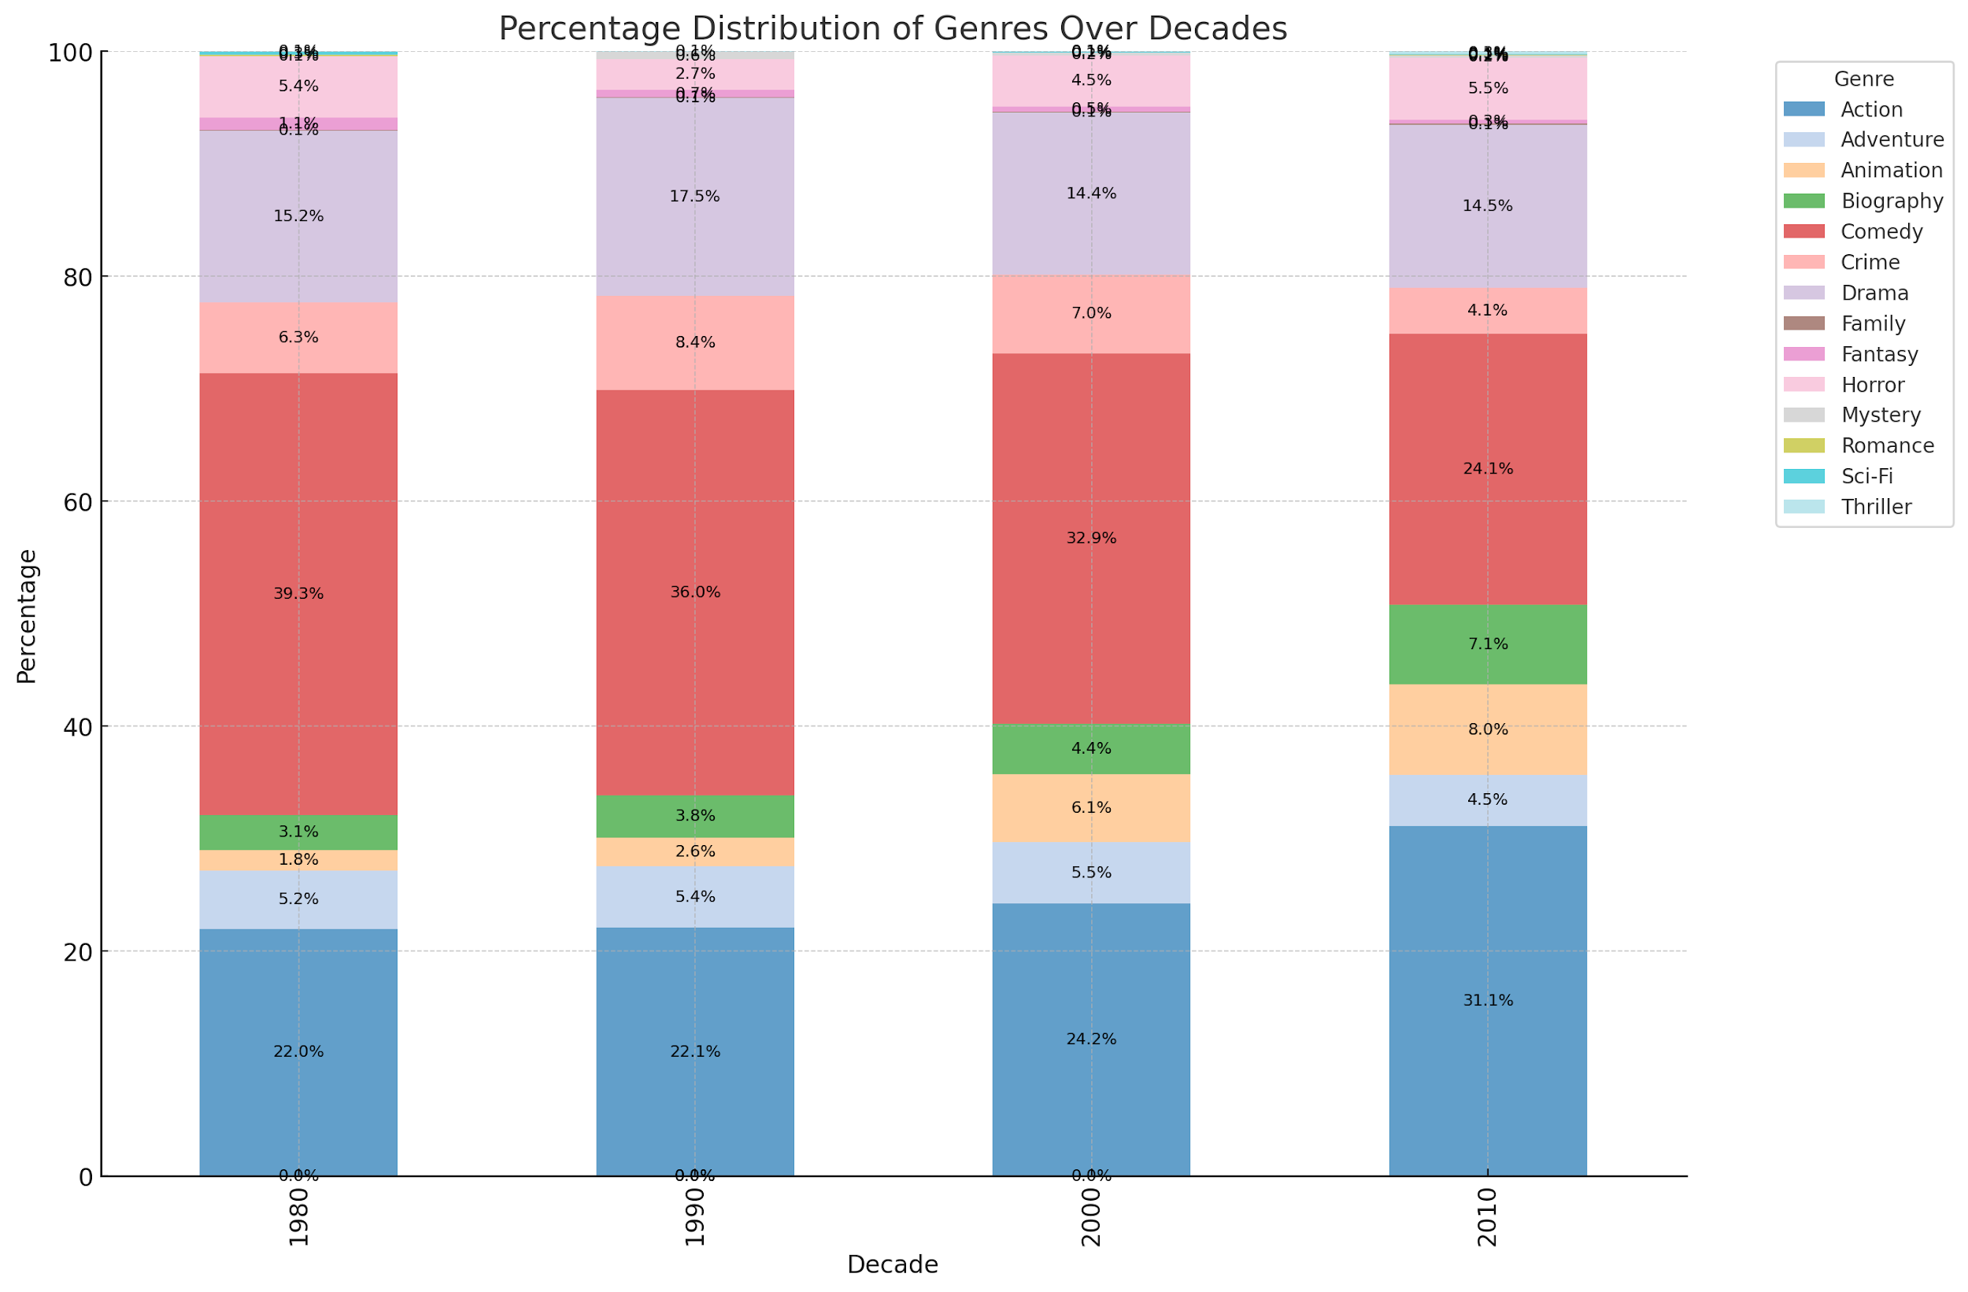
Key Business Finding and Insight # 3 (b)
Action has replaced Comedy as the largest genre being produced.
In the 2010s, the focus has shifted more towards bigger spectacle movies with Action + Adventure + Fantasy + Thriller + Animation being close to 45% of the total no of movies being produced for Theatrical release.
This could be due to more technology being made available and as a response to generating content which shows better in a theatrical release rather than as a streaming experience.

Slide 20
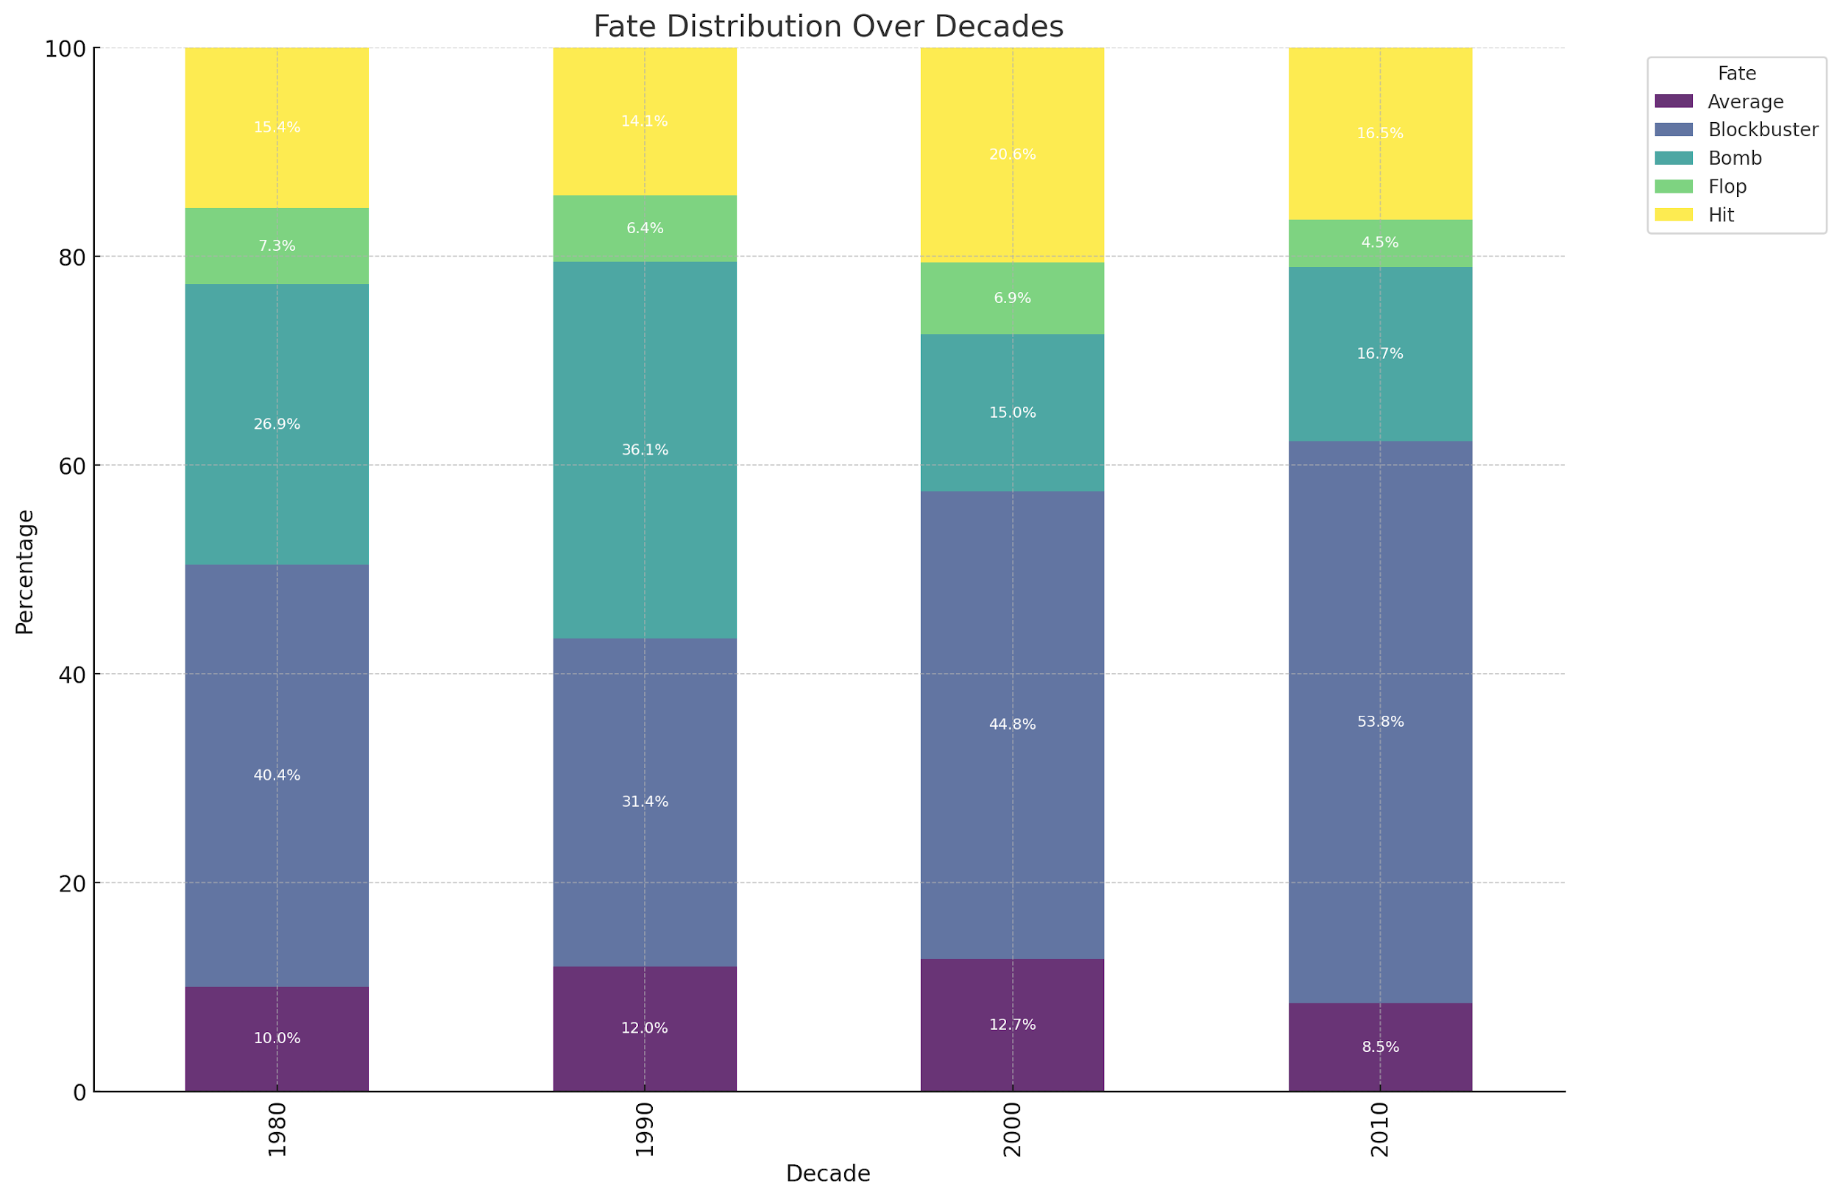
Key Business Finding and Insight # 4(a)
Blockbusters have been increasing showing a trend towards bigger releases.
This ties in with the shift in genres towards bigger spectacle movies for Theatrical releases and a shift towards superhero and sequalized content.

Slide 21
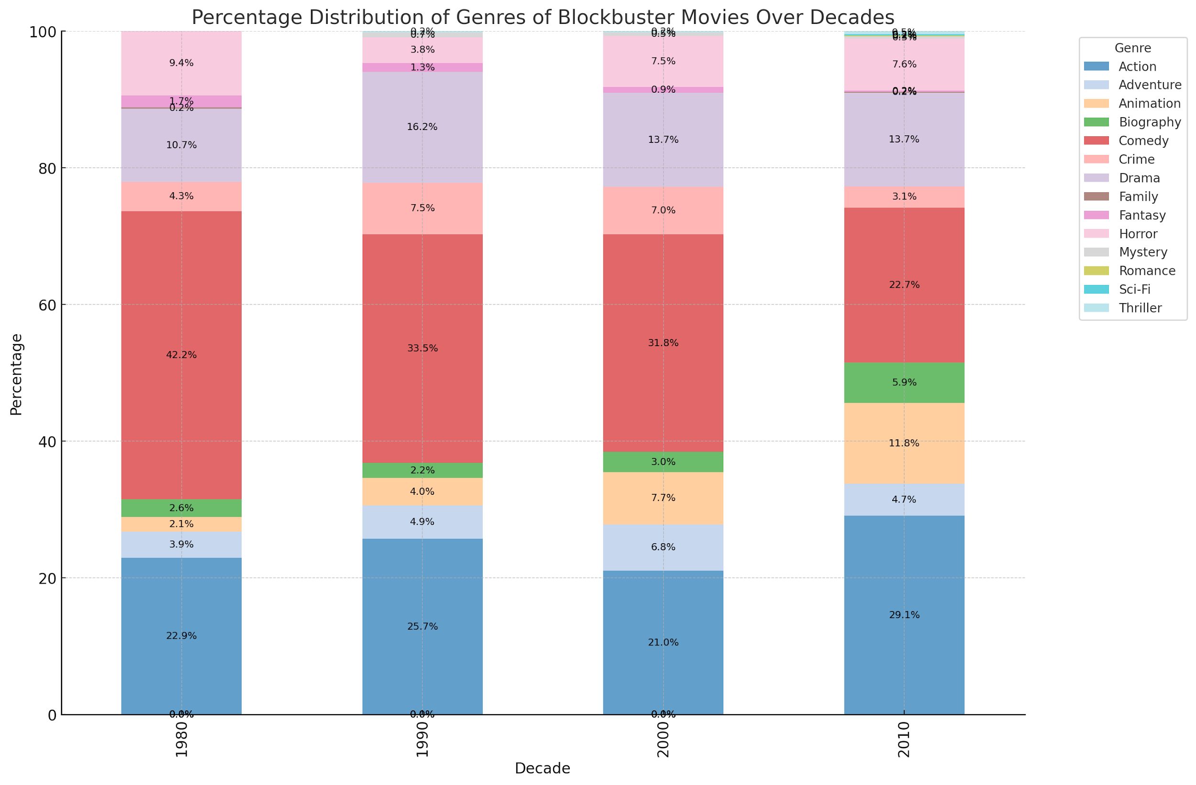
Key Business Finding and Insight # 4(b)
Action + Adventure + Animation makes up over 40% of the Blockbuster movies in decade of 2010.

Slide 22
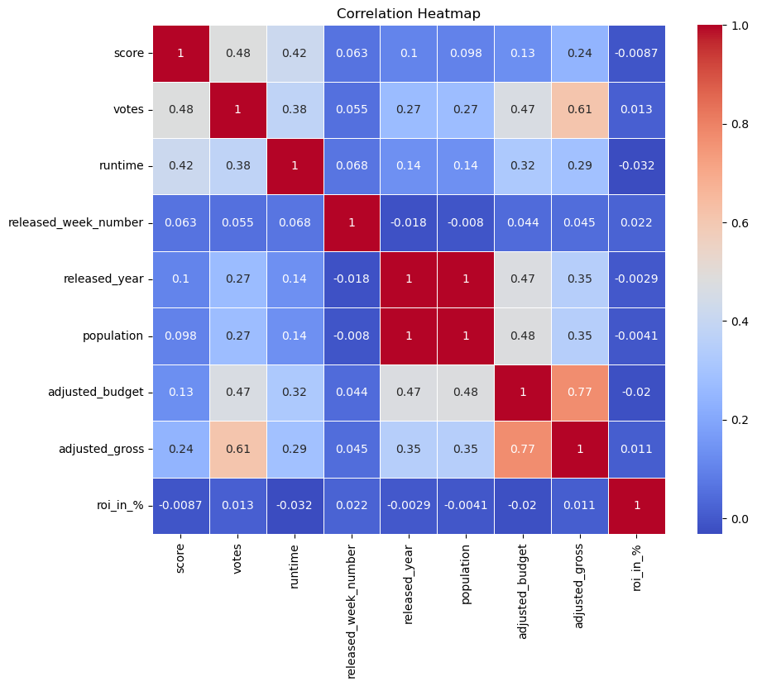
Key Business Finding and Insight # 5
Correlation Matrix
Strong correlation between “gross” and “budget”. Along with that “votes” and “gross” also seem to have some positive correlation.
“Population” and “Released Year” also have strong positive correlation.

Slide 23
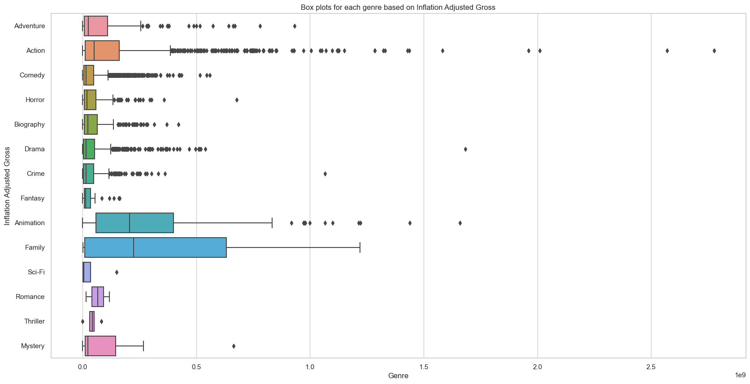
Key Business Finding and Insight # 6
Genre-wise Steady Performers
Genre-wise the Steady Performers are Animation + Family + Mystery with a larger box plot spanning higher gross revenues and lesser outliers.

Slide 24
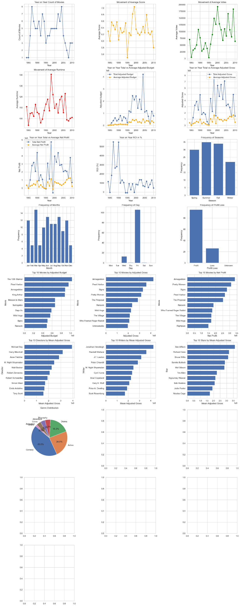
Key Business Finding and Insight # 7
E.g. Touchstone Pictures
Personalized Company Analysis
For Touchstone Pictures
We see a heavy reliance on Comedy + Action + Drama
Their Genre Portfolio can be made less risky by diversifying into Animation + Family + Horror

Slide 25

Model Development and Validations
Gross Revenue Prediction Model
Risk Rating Tool For Historical Movies
© 2021 Jigsaw Academy Education Pvt Ltd.

Slide 26
Gross Revenue Prediction Model
© 2021 Jigsaw Academy Education Pvt Ltd.

Slide 27
Predicting Gross Revenue
01
Parameter Selection
What are the correct parameters for model creation?
02
Data Transformation
03
Model Selection
Regression Analysis

Slide 28
Predicting Gross Revenue
Movie Name
Rating
01
Parameter Selection
Genre
What are the correct parameters for model creation?
Cause and After effect
Year
Score
Votes
Director
02
Data Transformation
Writer
Star
03
Model Selection
Adjusted budget
Regression Analysis
Adjusted Gross

Slide 29
Predicting Gross Revenue
Movie Name
4876 Unique values
Rating
01
Parameter Selection
Genre
14 Unique values
What are the correct parameters for model creation?
Cause and After effect
Categorical Vs Numerical Parameters
No. of Unique values
Year
Score
Votes
Director
1999 Unique values
02
Data Transformation
Writer
2999 Unique values
Star
1761 Unique values
03
Model Selection
Adjusted budget
Regression Analysis
Adjusted Gross

Slide 30
Predicting Gross Revenue
01
Parameter Selection
Genre
Year
Adjusted budget
Adjusted Gross
What are the correct parameters for model creation?
Cause and After effect
Categorical Vs Numerical Parameters
No. of Unique values
02
Data Transformation
03
Model Selection
Regression Analysis

Slide 31
Predicting Gross Revenue
01
Parameter Selection
Genre
Year
Adjusted budget
Adjusted Gross
What are the correct parameters for model creation?
Max
Min
2019
1980
Max
Min
284.1 M
1155
Max
Min
1.96 T
677.1
1980
02
Data Transformation
Range of the data
03
Model Selection
Regression Analysis

Slide 32
Predicting Gross Revenue
01
Parameter Selection
Genre
Year
Adjusted budget
Adjusted Gross
What are the correct parameters for model creation?
Max
Min
2019
1980
Max
Min
284.1 M
1155
Max
Min
1.96 T
677.1
1980
02
Data Transformation
Range of the data- Standard scaler of sklearn (Z-transformation)
Max
Min
2019
1980
Max
Min
8.147
-0.765
Max
Min
13.368
-0.518
1980
03
Model Selection
Regression Analysis

Slide 33
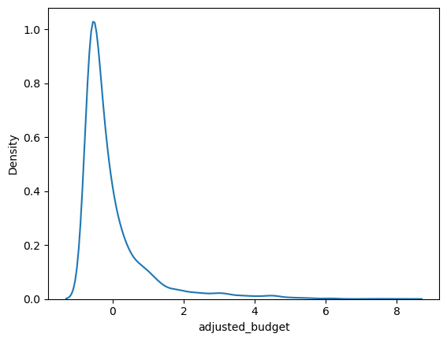
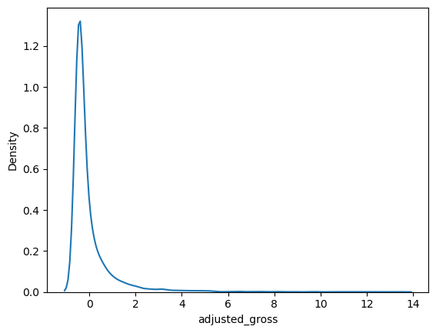
Predicting Gross Revenue
01
Parameter Selection
Genre
Year
Adjusted budget
Adjusted Gross
What are the correct parameters for model creation?
Max
Min
2019
1980
Max
Min
8.147
-0.765
Max
Min
13.368
-0.518
1980
02
Data Transformation
Range of the data- Standard scaler of sklearn (Z-transformation)
Skewness of the data
03
Model Selection
Regression Analysis

Slide 34
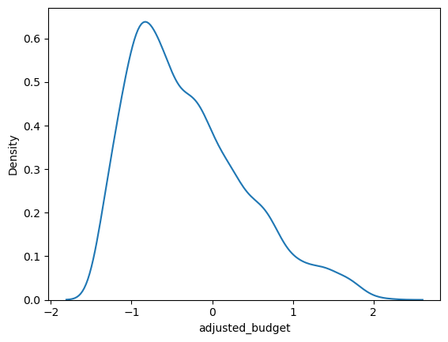
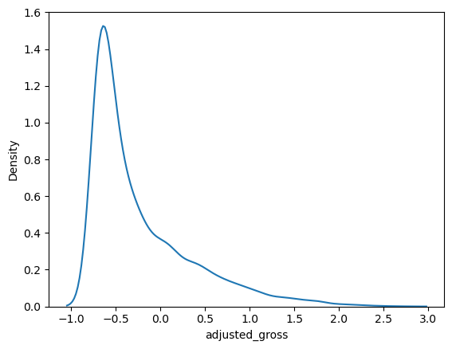
Predicting Gross Revenue
01
Parameter Selection
Genre
Year
Adjusted budget
Adjusted Gross
What are the correct parameters for model creation?
02
Data Transformation
Range of the data- Standard scaler of sklearn (Z-transformation)
Skewness of the data- Log transform
03
Model Selection
Regression Analysis

Slide 35
Predicting Gross Revenue
01
Parameter Selection
Genre
Year
Adjusted budget
Adjusted Gross
What are the correct parameters for model creation?
02
Data Transformation
Encoding
Range of the data- Standard scaler of sklearn (Z-transformation)
Skewness of the data- Log transform
Genre was then encoded to convert categorical data to numerical data
03
Model Selection
Regression Analysis

Slide 36
Predicting Gross Revenue
58%
1.52
Linear regression
01
Parameter Selection
31.2%
0.50
What are the correct parameters for model creation?
Polynomial regression
02
Data Transformation
99.2%
0.07
Random forest Regressor
03
Model Selection
98.7%
0.18
Regression Analysis
Decision Trees
Multiple models were tried for best results
99.2%
0.10
Gradient Boosting

Slide 37
Predicting Gross Revenue
R2 Score
MAPE
Linear regression
58%
1.52
01
Parameter Selection
Polynomial regression
31.2%
0.50
What are the correct parameters for model creation?
02
Data Transformation
Random forest Regressor
99.2%
0.07
03
Model Selection
Regression Analysis
Decision Trees
98.7%
0.18
Multiple models were tried for best results
Random forest Regressor gave the best results.
Gradient Boosting
99.2%
0.10

Slide 38
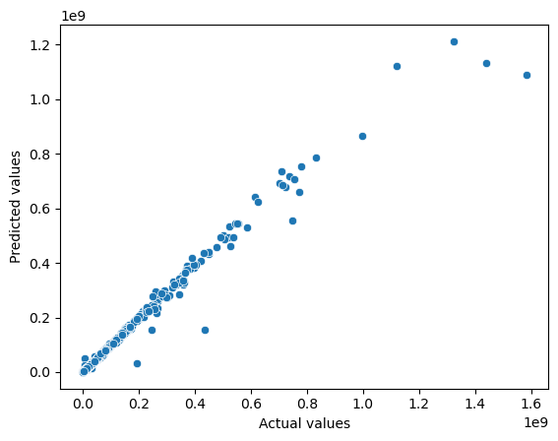
Predicting Gross Revenue
R2 Score
MAPE
Random forest Regressor
99.2%
0.07
01
Parameter Selection
What are the correct parameters for model creation?
02
Data Transformation
03
Model Selection
Regression Analysis
Multiple models were tried for best results
Random forest Regressor gave the best results.
Results gave almost straight line.

Slide 39
Risk Rating Tool for Historical Movies
© 2021 Jigsaw Academy Education Pvt Ltd.

Slide 40
Rating Risk for Historical Movies
Director + Genre Risk
Logic:
Find out the Risk Rating for a considered Project
For that, find out the individual risk ratings for Director, Star, Writer based on their performance in a particular genre
For that, numerically assign the risk by the historical performance features of Fate and ROI in %
For that, find out the Feature Importance for the Fate and ROI features
For that, fit a regression model limited to these features and get the feature importance
Writer + Genre Risk
Fate Risk Weight
Total Project Risk Rating
Feature + Genre Risk Rating
ROI in % Risk Weight
Star + Genre Risk
Company + Genre Risk

Slide 41
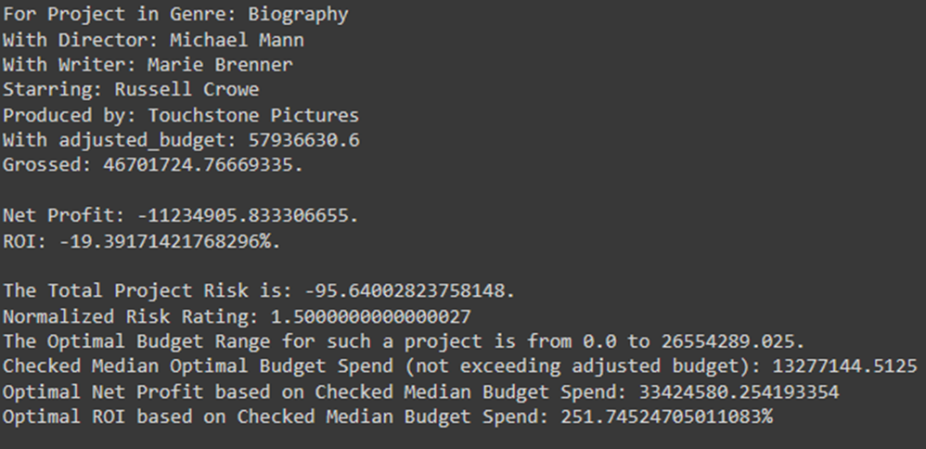
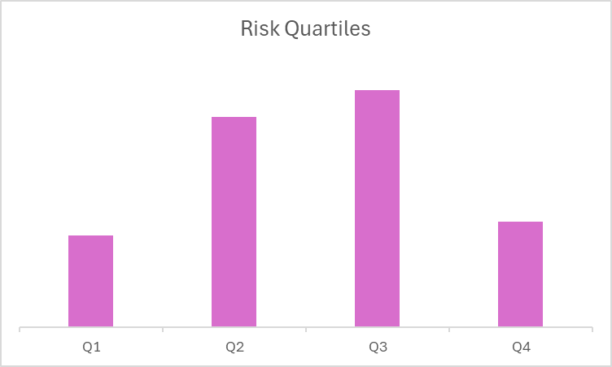
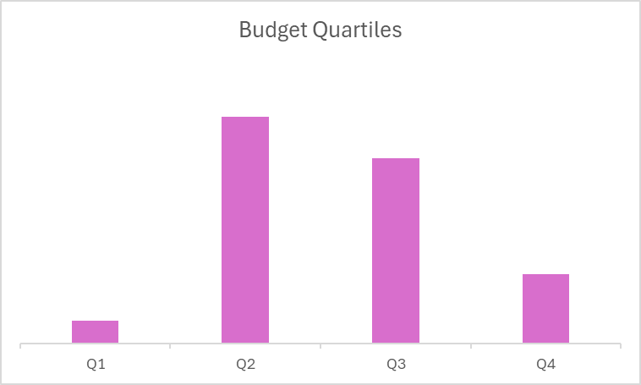
Rating Risk for Historical Movies
Finding out the Risk Quartiles for each historical Movie Project for that particular Year in that particular Genre
Finding out the Budget Quartiles for each historical Movie Project for that particular Year in that particular Genre
Normalizing them to remove skewness
For indicative purpose only

Slide 42
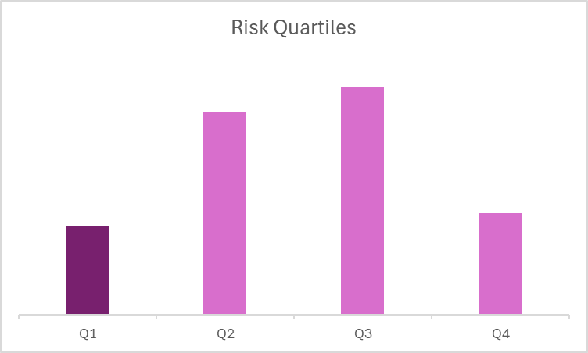
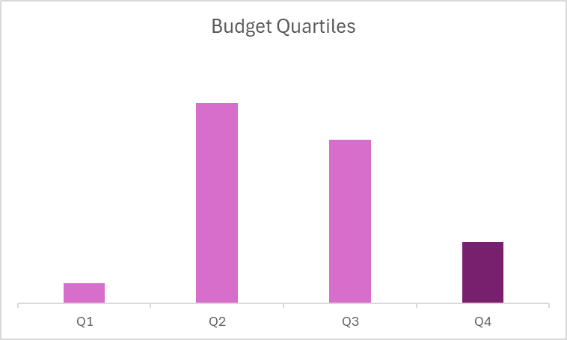
Rating Risk for Historical Movies
Inversely superimposing Budget Quartiles with Risk Quartiles
Q1 of Risk Quartile (lowest risk projects) = Q4 of Budget Quartile (highest budget range)
Q4 of Risk Quartile (highest risk projects) = Q1 of Budget Quartile (lowest budget range)
This gives Optimal Budget Range which indicates if the project OVERSPENT and could use budget curtailing, all things kept same.
For indicative purpose only

Slide 43
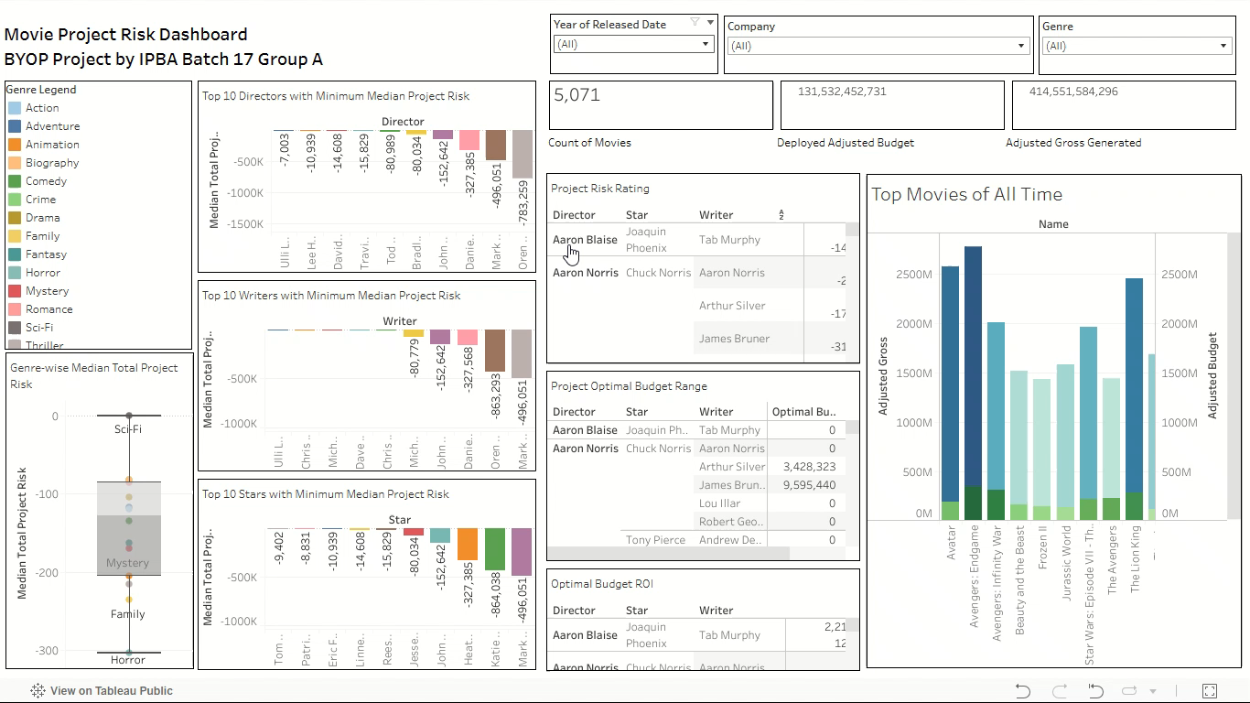
Tableau Dashboard: IPBA Movie Project Risk Dashboard | Tableau Public

Slide 44

Business Recommendations and Impact
© 2021 Jigsaw Academy Education Pvt Ltd.

Slide 45




Business Recommendations
Focus on lesser risky Genres like Horror, Family, Thriller, Animation, and Mystery
Risk Rating Dashboard can be used for selecting Cast and Crew for a considered Project
Optimal Budget can be considered based on the selected Cast and Crew for a considered Project
Based on Revenue predicted the investment in the considered Project can be pondered upon.
Market trends and historical company-based analysis can help guide projects and investment decision-making
© 2021 Jigsaw Academy Education Pvt Ltd.

Slide 46

Next Steps
© 2021 Jigsaw Academy Education Pvt Ltd.

Slide 47
IMDB Score Prediction Modelling
© 2021 Jigsaw Academy Education Pvt Ltd.

Slide 48
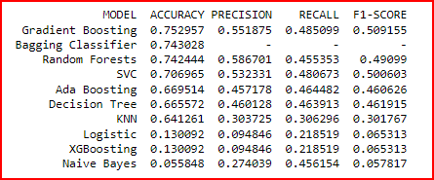
Movies Score Prediction Modelling- Award Prestige
Objective of this sub-project was to create a model which can accurately forecast IMDB score for a movie, basis various input variables including; budget, gross, rating, weekday of release, season of release etc.
This forecasting will help production house to define content strategy, drive audience engagement, right size resource allocation and mitigate their risk thus maximize revenue generation.

Slide 49
Thank You

Slide 50
Appendix
© 2021 Jigsaw Academy Education Pvt Ltd.

Slide 51
Appendix
Steps for Analysis in Python:
Importing all relevant libraries.
Loading data in Jupyter Console (movies_small.csv), Called it “dataset”
Removing all countries and keeping on movies from USA. Finally dropping “country” column, as it is irrelevant now.
Deriving “released_country”, “release_date”, “released_day_of_week”, “released_week_number”, “released_month” & “released_year” from “released” column. Finally deleting “released” column.
Identifying “season” when movie got released referencing “released_month”.
Understanding missing values%, unique values and datatype for each column.
Updating & homogenizing the “rating” column. (TV-PG': 'PG’, 'TV-MA': 'NC-17’, 'Not Rated': 'Unrated’. Removed movies with Approved “rating”, as there was only one movie.
Deleted rows where genre was Sports & Western, as there was only one movie.
Dropped data rows where “rating”, “score”, “votes”, “runtime” and “company” was NaN.
Imputed missing values in “budget” and “gross” by median value of “budget” or “gross” for movies within same genre and same year. Removed all rows where “gross” or “budget” were still zero.
Calculated inflation “adjusted gross” and “adjusted budget” using Population Ratio and CPI Index. These were the columns which were used subsequently for all analysis. Removed original “budget” and “gross” columns from the main data. Called in “merged_df”
© 2021 Jigsaw Academy Education Pvt Ltd.

Slide 52
Appendix
STEPS FOR ANALYSIS IN PYTHON:
l) Calculated net profit and ROI as:
Net profit= adjusted gross- adjusted budget
ROI % = Net Profit*100/adjusted budget
m) Removed data for year “2020” as data for 2020 was skewed with only 11 datapoints.
n) Defined new column “fate”, which defined how movie performed:
#Movie that earned more than 2.5x budget - is a BLOCKBUSTER.
#Movie that earned more than 1.5x budget - would be a HIT.
#Movie that earned as much as the budget - would be a AVERAGE.
#Movie that earned less than budget - would be a FLOP.
#Movie that earned less than 3/4 of budget - would be a box office BOMB.
© 2021 Jigsaw Academy Education Pvt Ltd.

Slide 53
Appendix
EXPLORATORY DATA ANALYSIS
Counts of movies by Year.
Count of movies by genre.
Total Gross and budget by genre (inflation adjusted).
Top 10 movies by budget and gross.
Number of movies by ratings.
Number of movies released by each company.
Distribution of Genre amongst Top5 Production Houses.
Number of movies, total gross & total budget for top 10 directors, stars, and writers.
Popularity for each director, star, and writer, through average scores.
Average movie score fluctuations over years.
Aggregate total votes over years.
Average runtime of movies changed over years & Bucketing of movies by runtime range.
Counts of movies by Year.
Count of movies by genre.
Total Gross and budget by genre (inflation adjusted).
Top 10 movies by budget and gross.
Number of movies by ratings.
Number of movies released by each company.
Distribution of Genre amongst Top5 Production Houses.
Number of movies, total gross & total budget for top 10 directors, stars, and writers.
© 2021 Jigsaw Academy Education Pvt Ltd.

Slide 54
Appendix
EXPLORATORY DATA ANALYSIS
Popularity for each director, star, and writer, through average scores.
Average movie score fluctuations over years & Bucketing of movies by Score.
Aggregate total votes over years.
Average runtime of movies changed over years & Bucketing of movies by runtime range.
Top 10 movies with highest scores.
Correlation between different numerical variables?
Fate of movies by genre & Season
Count of movies released by Season
% of profitable movies by Writer, Director, Actor
Scatter Plot Population and Movies Gross
Adjusted budget over time
Count of movies grouping by genre and profit_loss
profit_loss grouped by genre over time
Bar plot for Genre vs Inflation Adjusted Gross
Count of movies released by Season
% of profitable movies by Writer, Director, Actor
Scatter Plot Population and Movies Gross
Adjusted budget over time
Count of movies grouping by genre and profit_loss
© 2021 Jigsaw Academy Education Pvt Ltd.

Slide 55
Appendix
EXPLORATORY DATA ANALYSIS
profit_loss grouped by genre over time
Bar plot for Genre vs Inflation Adjusted Gross.
Bar plot for Genre vs Inflation Adjusted Budget.
Inflation adjusted Budget and Gross by genre.
Total net profit for each year.
Total Net profit by genre.
Plotting genre freq distribution.
Box Plots for inflation adjusted budget for each genre
Top 10 companies by number of movies released.
Adjusted budget and adjusted gross frequency distribution.
Creation of a Company-wise dashboard
Total Movie Count and Adjusted Budget and Mean Adjusted Budget for Top 10 companies
Count of movies by Fate Frequency for the Top 10 Companies combined
Count of Movies by Genre Type for the Top 10 Companies combined
Genre-wise count of movies and total adjusted budget and mean adjusted budget
Count of movies by Fate Frequency for the Top 10 Companies combined.
Count of Movies by Genre Type for the Top 10 Companies combined.
Genre-wise count of movies and total adjusted budget and mean adjusted budget.
© 2021 Jigsaw Academy Education Pvt Ltd.

Slide 56
Appendix
EXPLORATORY DATA ANALYSIS
Genre-mix distribution for Top 10 companies over years.
Genre-wise profit and loss effect on budget allocated
Genre-wise score effect on budget allocated
Genre-wise votes effect on budget allocated
Count of Unique companies releasing movies each year.
Y data profiling
© 2021 Jigsaw Academy Education Pvt Ltd.

